Slide 1
Leveraging User Interaction Signals for Web Image Search
Authors: Neil O’Hare, Paloma de Juan, Rossano Schifanella, Yunlong He, Dawei Yin, Yi Chang
Source: SIGIR ’16
Date: 2017/6/13
Advisor: Professor Jia-ling Koh Speaker: Bo-Wen, chiang
Notes:
利用使用者的互動訊號進行網頁圖片搜尋

Slide 2
Outline
•Introduction
•Method
•Experiment
•Conclusion

Slide 3
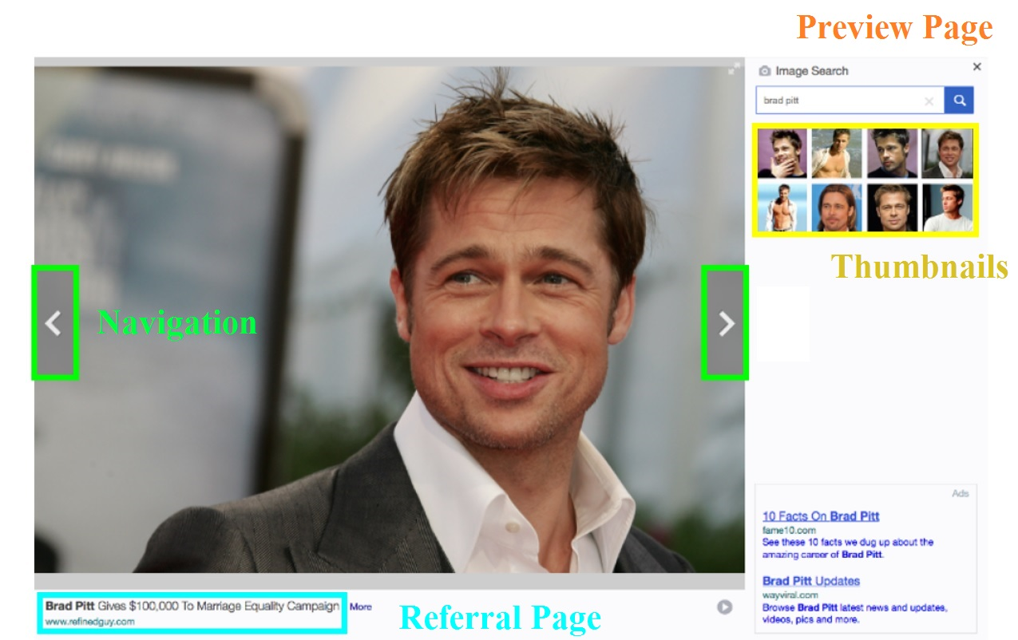
Introduction
Notes:
布萊德・彼特: 美國男演員及電影製片人
Web圖片搜索引擎結果的使用者界面與傳統（文本）網絡搜索結果的界面有很大的不同，支持更豐富的互動。 Hover 懸停 導覽 可以依序瀏覽搜尋結果的圖片 縮圖表，可跳躍式瀏覽 來源網頁， 圖片是出自哪個網頁被圖片搜尋引擎抓取到的

Slide 4
Introduction
Motive
Goal
we address this gap by leveraging the rich user interactions with web image search results to extract implicit relevance feedback information and improve search engine rankings.
Notes:
動機是改善現有網頁圖片搜索的效果
目的
透過 利用豐富的使用者與網頁圖片搜索結果的互動來提取隱含的相關性反饋信息並提高搜索引擎排名來解決這一差距。

Slide 5
Outline
•Introduction
•Method
•Experiment
•Conclusion

Slide 6
Method
IMAGE SEARCH USER INTERACTION
- hover - Thumbnails - Navigation - Referral Page
Context of Images in Web
Relevance Requirements for Image Search

Slide 7
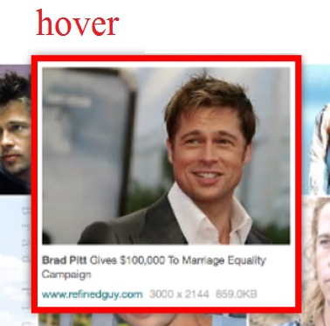
Method
Implicit relevance feedback features
from the Image Search Results Page (SRP)
click-through rate (CTR)
hover-through rate (HTR)
converted hover rate (CHR)

Slide 8
Method
Implicit relevance feedback features
from the Image Preview Page
Referral Page Click-through Rate (RP-CTR)
Dwell Time Features
Absolute dwell time features: the dwell time in seconds, and the log of the dwell time.
Normalised dwell time features: dwell time can be dependent on both the user and the task.
Binary categorical dwell time features

Slide 9
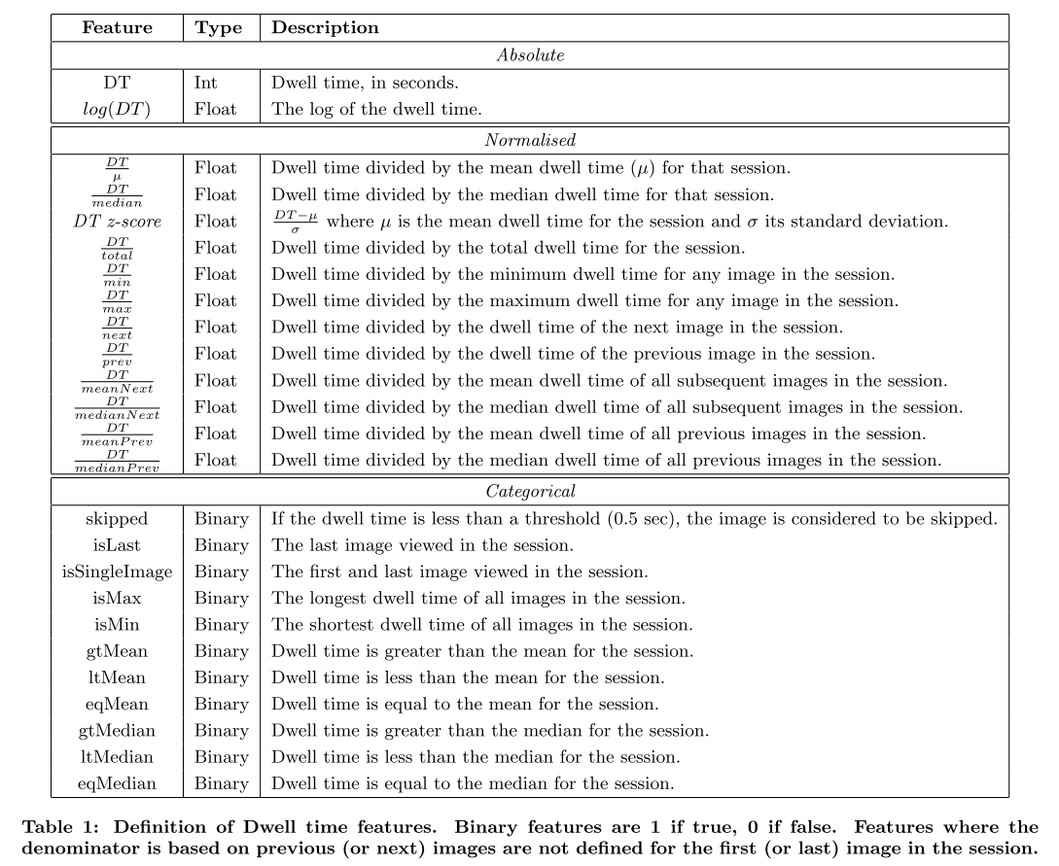
Notes:
p563

Slide 10
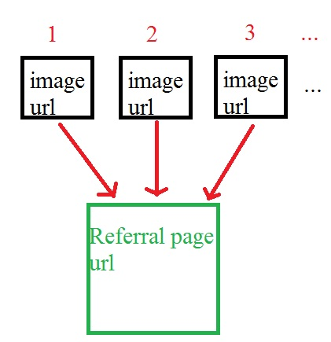
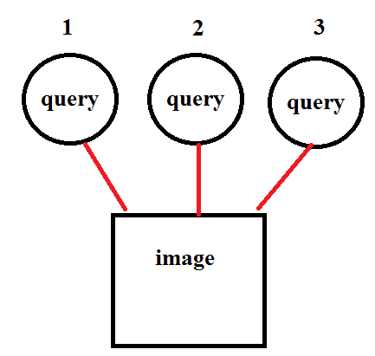
Method
Propagating Implicit Feedback Features
we have three levels of propagation for the user behavior features:
1. Q-URL. (image url, query) The query is associated with the image URL for the clicked/viewed image
this is our default setting and, if not otherwise stated, this version of the implicit feedback features is being used.
2. Q-Refpage (referral page url, query)
3. Q-Independent.

Slide 11
Outline
•Introduction
•Method
•Experiment
•Conclusion

Slide 12
Experiment
DATA
Yahoo search engine log data
covering a 6 month period from July 2014 to December 2014
extract the following fields from each entry in the log: session id, timestamp, query string, anonymous user identifier, page type, and event type (i.e. pageview, click).
Corpus for Web Image Search
queries from the top 50% of this traffic
total of 9,272 queries

Slide 13
Experiment
Corpus
Relevance Annotations (By professional editors)
topical relevance (3 pointscale)
Relevant、 Moderately Relevant、Non Relevant.
image quality (5-point)
Exceptional、Professional、 Good 、 Fair 、 Bad
Combined relevance + quality (5-point)
Perfect, Excellent, Good, Fair, Bad

Slide 14
Experiment

Slide 15
Experiment
Notes:
B1：第一組功能純粹基於內容，因為它不包含有關使用者互動的資訊
- Query 特徵：Query長度，Query頻率，Query類別等
文本匹配：基於文檔文本和錨文本的功能。
B2：除了B1的所有特徵之外，包括query-圖片URL pairs 的點擊率(CTR)的相關性feedback，意思是有包含這個baseline方法。
（NDCG）作為指標來評估搜索相關性。

Slide 16
Experiment

Slide 17
Outline
•Introduction
•Method
•Experiment
•Conclusion

Slide 18
Conclusion
We propose a ‘hover’ rate feature based on an image-specific interaction on the Search Results Page.
We propose two sets of user behavior features based on user interactions with the image Preview Page : (i) click-through from the preview page to the host/referral page where the image is embedded, and (ii) a set of dwell time features.
We evaluate these novel features in a learning to rank framework using a large scale annotated corpus, and show that they achieve significant improvements over a strong baseline based on standard click features.
Notes:
第一點: 根據搜索結果頁面上的圖片特定互動提出一個“懸停”率。
第二點:基於使用者與圖片預覽頁面的互動提出兩組用戶行為特徵：
（i）透過點擊 從預覽的頁面到 存放圖片的參考頁面
（ii）一組停留時間 特徵。 第三點: 使用大規模標註的語料庫來評估這些新穎特徵，並顯示出基於過去點擊特徵，實現更強大的顯著的改進。

